Slide 1
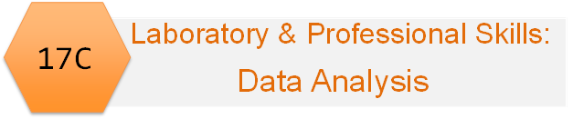
Laboratory & professional skills for Bioscientists term 3: Data Analysis in R
Revision: Overview and Developing understanding of term 2 statistics

Slide 2
Overview
Module LO reminder
What is the biological question
Organising your data and analysis
Overview for Choosing tests
Figures
Introduction to the Workshop

Slide 3
Module Learning Outcomes
The successful student will be able to:
Explain the purpose of data analysis
Name, identify and choose classical univariate statistical tests (and some non-parametric equivalents) appropriate to a given scenario and recognise when these are not suitable
Use R to perform these analyses on data in a variety of formats
Interpret, report and graphically present the results of covered tests
Meeting the learning outcomes will enable you to:
Write-up your laboratory report
Design and analyse experiments including those for projects in stages 2, 3, and 4 and year-away
Evaluate and interpret the data analysis in papers
Perform well in assessments
Improve your employability!

Slide 4
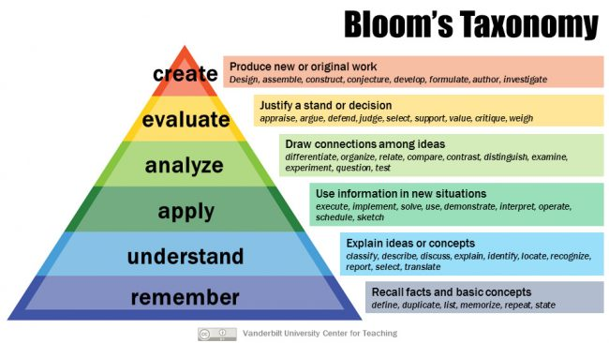

Slide 5
What is the biological question?
Very many ‘statistics’ problems are biology problems
Think about your questions before you design experiments
What is your response variable?
What are your explanatory variables?
Generate dummy data

Slide 6


What is the biological question?
Response: blood pressure
Explanatory variables you want to understand: drug
Explanatory variable for control: sex, age, disease??

Slide 7
What is the biological question?
Tests apply to a particular question
Statistics are just evidence: as references are to your introduction, statistics are to your results.
At this level you should be able to outline results are before the statistical analysis
A
B
C

Slide 8
Outline the results
Drug A looks better than drugs B and C
A
B
C
Drug

Slide 9
Statistical evidence for results being real
Drug A is better than drugs B and C
A
B
C
Drug

Slide 10
Or not…
A
B
C
Drug

Slide 11
Collecting data
Design and execute your experiment
Experimental design and data analysis go hand-in-hand
Type of experiment determines statistics
But understanding of statistics informs design
Organise your data in ’tidy’ format
Workshop

Slide 12
Collecting data
Organise your data in ’tidy’ format
Fine to use a spread sheet but save in a plain text format (txt, csv, dat, etc)
Write data straight into a blank tidy format
Wickham, H. (2014), “Tidy Data,” Journal of Statistical Software, 59, available at http://www.jstatsoft.org/article/view/v059i10

Slide 13
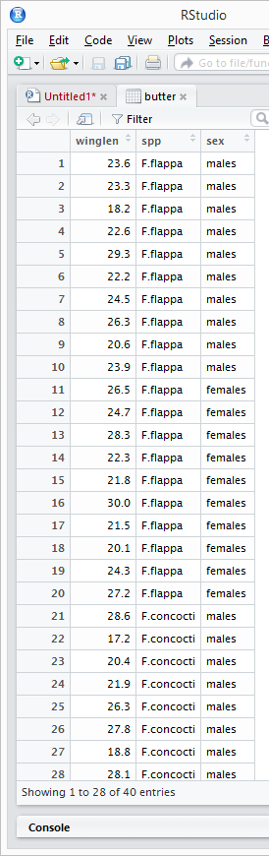
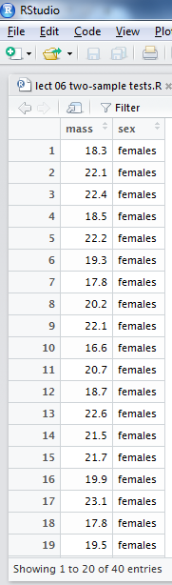
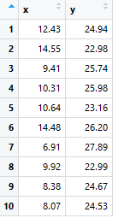
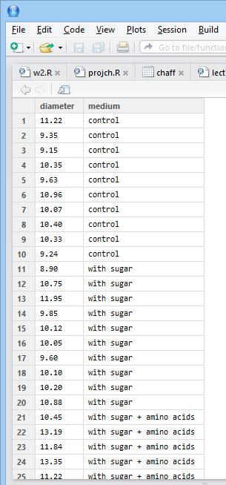
Response all in one column
Additional column for each explanatory
i.e., case (individual) per row

Slide 14
Before the experiment: Have some idea what test you’ll be doing
Always better to do BEFORE you design experiments and collect data
Consider assumptions
Take appropriate action – transform or chose another test

Slide 15
After the experiment: Explore your data
Frequency histograms
Scatter plots – geom_point()
Boxplots
Descriptive statistics – often absent from reports.
Sample sizes/number of cases
Variables
Means/medians, s.e
You don’t put all your exploring in your report

Slide 16
Overview of experiments and analysis
One explanatory
Something we measure
Can be explained by
Some things we control, choose or set
x- axis

Slide 17
Overview of experiments and analysis
Two explanatory
Something we measure
Can be explained by
Some things we control, choose or set
x- axis
Colour

Slide 18
Overview of experiments and analysis
Three explanatory
Something we measure
Can be explained by
Some things we control, choose or set
x- axis
Colour
Shape

Slide 19
Overview of experiments and analysis
Four explanatory
Something we measure
Can be explained by
Some things we control, choose or set
x- axis
Colour
Shape
Facet

Slide 20

Overview of experiments and analysis
Something we measure
Can be explained by
Some things we control, choose or set
Response variable
Dependent variable
The ‘y’ s
Relationship
Explanatory variables
Independent variable(s)
The ‘x’ s
function(y ~ x)
function(y ~ x₁ * x₂)

Slide 21
Choosing the analysis
The type of values the variables can take and the number of variables determines the test
Type of Response variable
Continuous or discrete? If continuous, normal?
can be explained by
What relationship links the predictors to the response? Linear?
Explanatory variables
Number: one? or more?
Type: continuous? categories?
function(y ~ x)
function(y ~ x₁ * x₂)

Slide 22
Choosing the analysis: simplification
The type of values the variables can take and the number of variables determines the test
Explanatory variables
Number: one? or more?
Type: continuous? categories?
Regression /
Correlation
Continuous
t-tests /
wilcoxon
Categorical
One-way ANOVA / Kruskal-Wallis
One or two Categories
One Categorical
Two
Categorical
Two-way ANOVA
Two or more Categories

Slide 23
Choosing the analysis: simplification
The type of values the variables can take and the number of variables determines the test
Type of Response variable (residuals)
Normally distributed
Not normally distributed
Explanatory variables
Number: one? or more?
Type: continuous? categories?
Regression /
Correlation
Continuous
t-tests /
wilcoxon
Categorical
One-way ANOVA / Kruskal-Wallis
One or two Categories
One Categorical
Two
Categorical
Two-way ANOVA
Two or more Categories

Slide 24
The ‘formula’ in t.test(), lm(), aov(), wilcox.test() etc, etc
are COLUMNS
aov(winglen ~ spp *sex, …)
t.test(mass ~ sex, …)
lm(y ~ x, …)
aov(diameter ~ medium, …)
function(y ~ x)
function(y ~ x₁ * x₂)

Slide 25
Non-parametric alternatives
Non-parametric tests make fewer assumptions
Based on the ranks rather than the actual data
Null hypotheses are about the mean rank (not the mean)
More conservative (less likely to be significant)
P values maybe estimates (may generate a warning). You can’t usually ‘fix’ that

Slide 26
Execute the test
Do results make sense based on your data exploration?
Chose APPROPRIATE figures and/or tables
Report results scientifically
Appropriate descriptive statistics
Results of test – significance, magnitude, direction
Explaining results – leave for the Discussion

Slide 27
Figures
Should match the test
t-tests, ANOVA tests on means thus figures show means
Wilcoxon, Mann-Whitney tests on ranks thus figures use medians/mean ranks
Correlation should NOT have line of best fit
Regression should have line of best fit
Likewise descriptive statistics

Slide 28
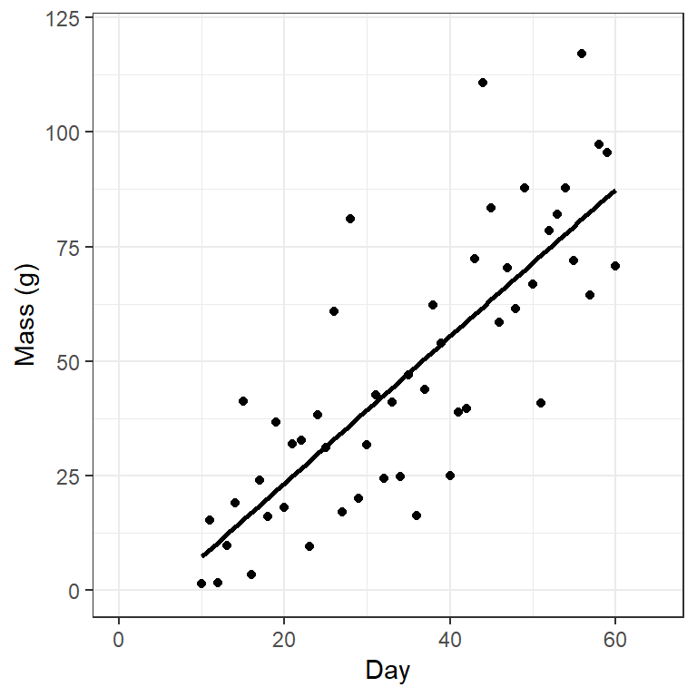
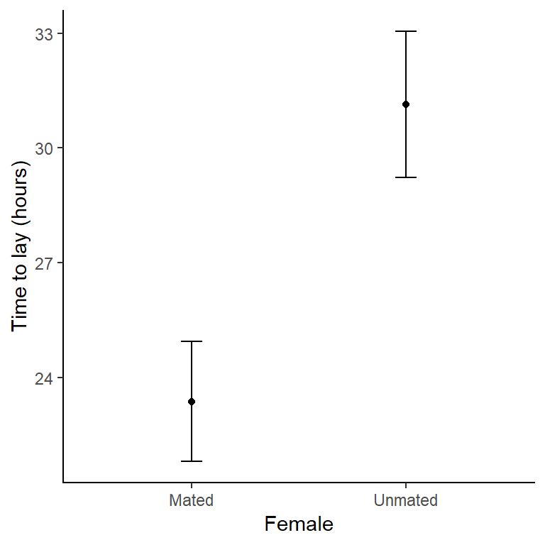
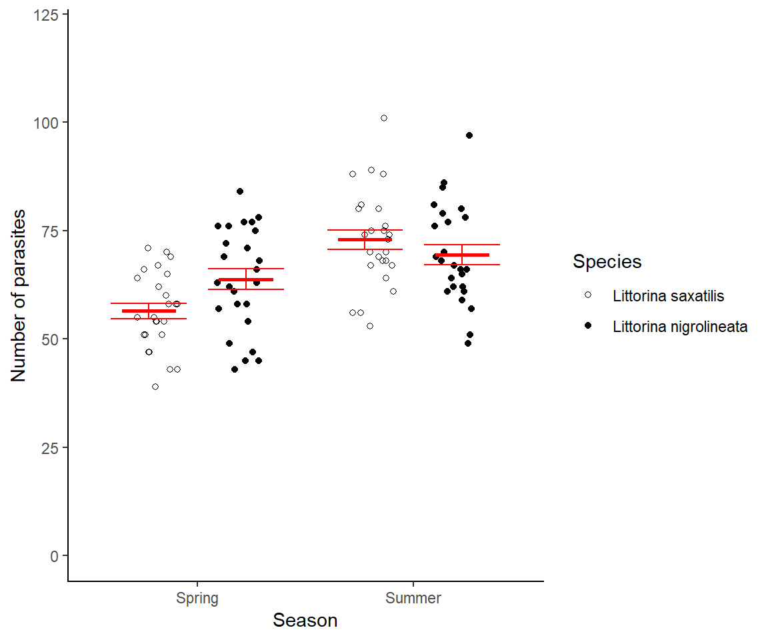
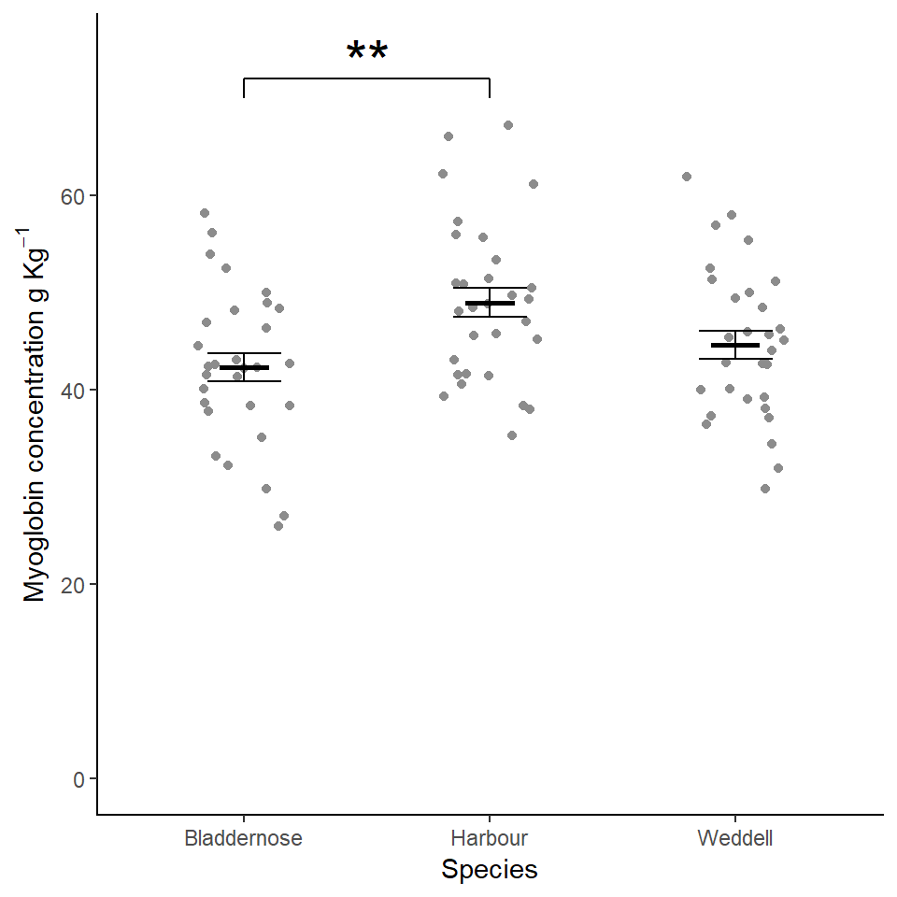
Parametric

Slide 29
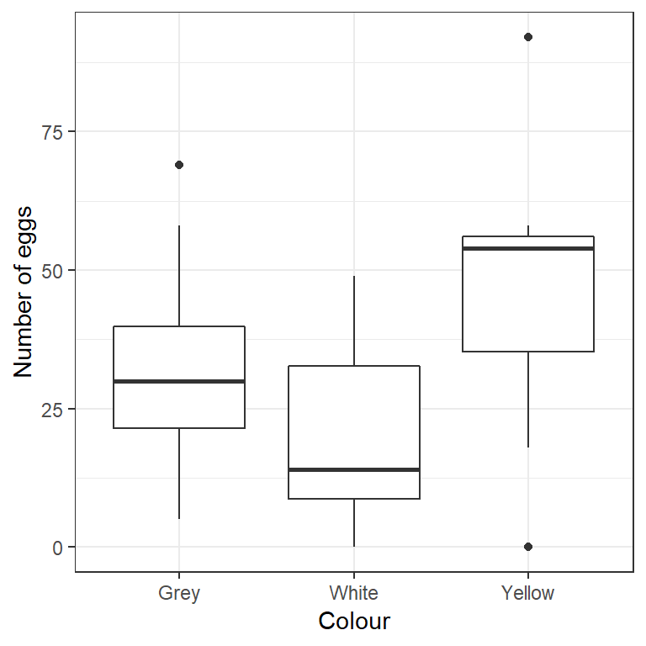
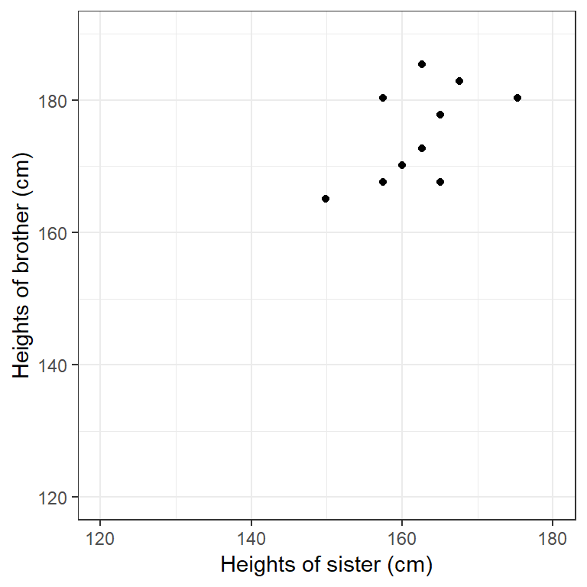
Non-parametric

Slide 30
Introduction to the practical
Designed to help you:
think about response and explanatory variables
organisation of data before experiment
understand how tests works
see the links between linear models
practice with figures
Scenarios for biological phenomena
identify an appropriate design and statistical test for the general research question
generate the data using the random number functions that would give the effects specified.
create figures to accompany the results

